Slide 1
Service-Oriented Architecture
Introduction to SOA

Slide 2
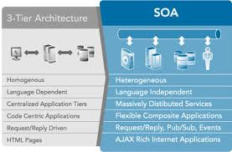
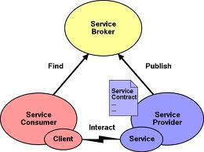
The Quest for SOA
SOA Overview
Some of you may already know what the term SOA means
  You may even know its basic ideas …
But we’re going to examine this concept from the ground up
Service-Oriented Architecture (SOA) means many different things to many different people …
  And as such … it can be hard to define and understand

Slide 3
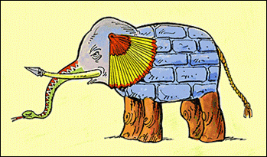
The Quest for SOA (cont’d)
SOA Overview
It is like John Godfrey Saxe’s poem about the blind men and the elephant.
  Six blind men happen upon an elephant and each touches a different part of the animal and then decide what it is
      The man touching the trunk believes it to be a snake
      The man touching the tusk believes it to be a spear
      The man touching the ear believes it to be a fan
      The man touching the elephant’s side believes it to be a wall
      The man touching the tail believes it to be a rope
      The man touching the legs believes they are trees
  Such is SOA – industry analysts, bloggers, reporters, managers and developers are able to identify the capabilities of SOA but fail to communicate the concept as a whole …

Slide 4
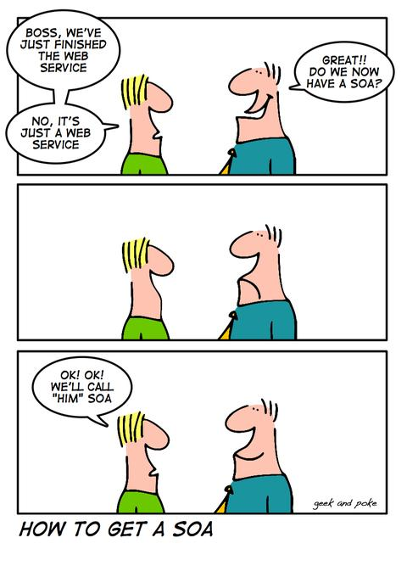
The Quest … (cont’d)
SOA Overview
Let’s start by trying to figure out what SOA is ourselves and watch 5 short videos
  SOA Confusion – Ask Greg
  SOA in 3 Minutes
  A commercial from Tibco
  The Music of SOA
  SOA Governance
Okay … so now what do you think SOA is ??
Notes:
Enterprise software
No duplicate of functionality – turn into service
Reducing effort, single point control, change
Loose coupling of service – wrapped in some comm protocol – contents of service independent of wrapper
Services published within organization (registry and repository)
How to call / talk to service, what to expect from service, security, who controls
Business functions which can be combined for overall larger function – pick and choose services to perform business process
Speed, business adapability

Slide 5

What is SOA?

Slide 6
SOA - Basic Concept
SOA Overview
SOA encapsulates many fundamental concepts that you already know, and is truly an enterprise type architecture
  SOA is really just a flexible set of design principles employed during the phases of the SDLC
    A system based on SOA will package functionality as a suite of interoperable services that can be used within multiple and separate systems
  SOA also provides a way for consumers of services to be made aware of SOA-based services
  Rather than defining an API, SOA defines a service’s interface in terms of protocols and functionality
SOA is not just an architecture of services seen from a technology perspective, but the policies, practices, and frameworks by which we ensure the right services are provided and consumed.

Slide 7
Okay – that sounds easy …
SOA Overview
All we need to do to begin working in SOA is
  Develop interoperable services
  Make sure that we get the word out that the services are available
  Ensure that we follow best practices in creating the interfaces by using messages and protocols
But where is it that SOA can be or is used ?
How is it that following SOA, we can
  take so many different pieces of code/functionality
  from so many different platforms and
  be able to call upon them whenever we need to ?

Slide 8
SOA Considerations
SOA Overview
When trying to develop a SOA you need to strive to ensure :
  Interoperability among different systems and programming languages which allow applications on different platforms to work together is best accomplished with a communication protocol
    E.g. Using messages to communicate. By using messages on defined message channels decreases the complexity of the service.
    The service developer can concentrate on the true functionality rather than the intricate needs of a communication protocol (potentially high overhead)
  Desire to develop services to a common set of resources
    Establish and maintain data flow to/from a federated database system
      A federated database is effectively a meta-database which integrates multiple databases into one central store – effectively creating a single data access point to all business data
    This allows any new functionality developed to access / reference a common format for each data element

Slide 9
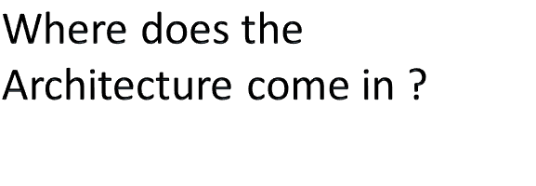
What is SOA?

Slide 10
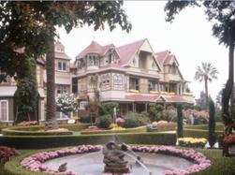
Where does SOA come from ?
SOA Overview
Given my description of SOA thus far, I’m sure that you all have ideas spinning around in your heads on how this could be accomplished … but are those ideas and solutions focused enough?
Consider the Winchester Mansion near San Jose, California
  The heiress of the Winchester (rifle) fortune believed
  that she was cursed and haunted by every soul killed
  by the rifle
  She was told that as long as she built a mansion
  (and kept building) she would not be harmed …
  She hired 147 builders and 0 architects. All of the
  builders worked simultaneously on the home for 38
  years until the heiress passed away
  In the end :
    The mansion contains 160 rooms, 40 bedrooms, 6 kitchens, 2 basements and 950 doors
    Of there 950 doors, 65 of them open to blank walls, 13 staircases were built and abandoned and 24 skylights were installed into various floors.
    No architectural blueprint for the mansion was ever created

Slide 11
Where does SOA come from ? (cont’d)
SOA Overview
When people confuse architecture with implementation, it generates chaotic and unpredictable results – much like the Winchester Mansion
  Articles that try to explain SOA and jump into a tutorial for building Web Services are providing guidance for implementation, not architecture
  This is one of the many reasons that SOA is so misunderstood today – the rush to promote loosely coupled architectures focuses on the trees instead of the forest.
The architectural concepts and models associated with SOA are not new – they are the natural evolution of current and accepted development models
  The 80’s saw object-oriented models
  Then came the component-based development model in the 90’s
  And now we have service orientation (SO)
    Service orientation retains the benefits of OO and component-based development (self-description, encapsulation, dynamic discovery and loading)
    But instead of remotely invoking methods on objects, SO facilitates the passing of messages between services
      Schemas describe not only the structure of messages, but also behavioral contracts to define acceptable message exchange patterns and policies to define service semantics
      This promotes interoperability, and thus provides adaptability benefits, as messages can be sent from one service to another without consideration of how the service handling those messages has been implemented.

Slide 12
SOA – The Evolution
SOA Overview
SOA is an architectural approach (not an implementation technique) to creating systems built from autonomous services
  With SOA, integration becomes forethought rather than afterthought - the end solution is likely to be composed of services developed in different programming languages, hosted on completely different platforms with a variety of security models and business processes
Service orientation (SO) provides an evolutionary approach to building distributed software that facilitates loosely coupled integration and resilience to change.
  With the advent of the Web Services, architecture has made service-oriented software development feasible by virtue of mainstream development tools support and broad industry interoperability.
  Although most frequently implemented using industry standard Web services, service orientation is independent of technology and its architectural patterns and can be used to connect with legacy systems as well.

Slide 13
SOA – The Evolution (cont’d)
SOA Overview
SO does offer some specific benefits when utilized for the right purpose. There are three important observations about SO:
  It’s evolutionary
    The principles of service-oriented development build on decades of experience in building real world distributed applications. SO incorporates concepts such as self-describing applications, explicit encapsulation, and dynamic loading of functionality at runtime – principles first introduced in the 1980s and 1990s through object-oriented and component-based development.
    What changes with SO is the metaphor with which developers achieve these benefits. Instead of using method invocation on an object reference, service orientation shifts the conversation to that of message passing – a proven metaphor for scalable distributed software integration.
  It’s not a product or technology
    It is a set of architectural principles expressed independently of any product.
    Just as development concepts such as polymorphism and encapsulation are independent of technology, so is service orientation.
  It’s incremental
    Finally, service orientation can and should be an incremental process – one that can often be done in-house.
    Customers should not be required to dramatically re-engineer their businesses to attain the benefits of service orientation. Rather, they should be able to leverage existing IT assets in doing so. Service-oriented development can often be achieved using the skills and technologies customers already have today.

Slide 14
SOA – The Evolution (cont’d)
SOA Overview
The fundamental building block of SOA is the service
A service is a program that can be interacted with through well-defined message exchanges
  Services must be designed for both availability and stability
  Services are built to last while service configurations and aggregations are built for change
    Services remain stable by relying upon standards-based interfaces and well-defined messages—for example using SOAP and XML schemas for message definition
    Services designed to perform simple, granular functions with limited knowledge of how messages are passed to or retrieved from it are much more likely to be reused within a larger SOA infrastructure.
When creating a SOA from your business processes – the architecture should strive for 3 goals :
  Connect into what is already there - Layer business process management, collaborative workflows, and reporting on top of existing IT assets.
  Extract more value from what is already there - Enable existing applications to be re-used in new ways.
  Extend and evolve what we already have - Create IT support for new cross-functional business processes that extend beyond the boundaries of what the existing applications were designed to do.

Slide 15

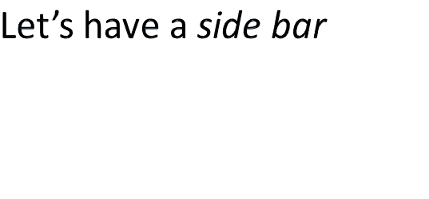
SOA

Slide 16
Editorial Comment
SOA Overview
As mentioned in the previous slides, the concept of SOA has been an evolutionary one
  It’s foundations started in the early 2000’s
  Developers and their organizations began to see a different way of hanging their programs and functionality together
    And people started to employ these ideas
And as the ideas of SOA began to take shape, more and more people noticed
  In the early days, proponents of SOA were professing their way of doing and achieving SOA
  As more people began to profess their way, organizations such as OASIS took notice and decided it was time for a SOA Reference Architecture Standard
    Most recently they have released their second draft of a SOA-RA Standard (July 2011) – 5 years after their first draft.
My point ??
  Its been close to a decade of organizations and developers guiding their businesses into a SOA
    The fact that there is no Industry Standard on how to do this hasn’t stopped them
    Truly showing that SOA is a Guiding Architectural Principle and not an implementation technique

Slide 17
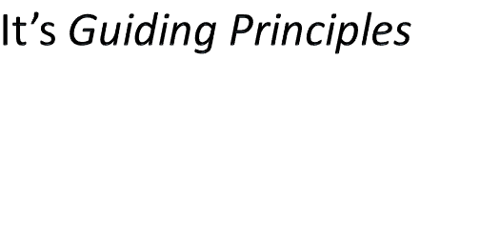
SOA

Slide 18
SOA Principles
SOA Overview
The following guiding principles define the ground rules for development, maintenance, and usage of the SOA
  reuse, granularity, modularity, composability, componentization and interoperability
  standards-compliance (both common and industry-specific).
  services identification and categorization, provisioning and delivery, and monitoring and tracking.
The first publicly published research of service-orientation from an industry perspective produced the eight specific service-orientation principles common to all primary SOA platforms
  Standardized Service Contract – Services adhere to a communications agreement, as defined collectively by one or more service-description documents.
  Service Loose Coupling – Services maintain a relationship that minimizes dependencies and only requires that they maintain an awareness of each other.
  Service Abstraction – Beyond descriptions in the service contract, services hide logic from the outside world.
  Service Reusability – Logic is divided into services with the intention of promoting reuse.
  Service Autonomy – Services have control over the logic they encapsulate.

Slide 19

SOA Principles (cont’d)
SOA Overview
  Service Granularity – A design consideration to provide optimal scope and right granular level of the business functionality in a service operation.
  Service Statelessness - Services minimize resource consumption by deferring the management of state information when necessary
  Service Discoverability – Services are supplemented with communicative meta data by which they can be effectively discovered and interpreted.
  Service Composability – Services are effective composition participants, regardless of the size and complexity of the composition.
Okay … to this point we’ve danced around the concepts and ideas that make a SOA
  Truthfully SOA is a meta-idea
    It is the ability to view your organization from the outside and from all angles
    To see the overall flow of business practices and processes
    To see the individual data building blocks that need to be created, processed and handled
    To re-architect your current business models, data blocks, processes, etc. so that they can all co-exist, work together, be called upon and operate in harmony
  Sounds very Zen – doesn’t it ??

Slide 20
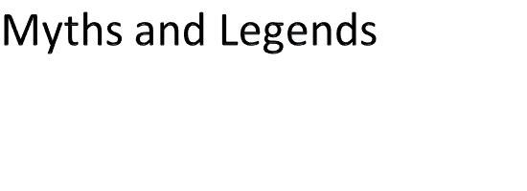
SOA

Slide 21
SOA Overview
Myth | Fact
SOA is a technology | SOA is a design philosophy independent of any vendor, product, technology or industry trend. No vendor will ever offer a “complete” SOA “stack” because SOA needs vary from one organization to another. Purchasing your SOA infrastructure from a single vendor defeats the purpose of investing in SOA
SOAs require Web Services | SOAs may be realized via Web services but Web services are not necessarily required to implement SOA
SOA is new and revolutionary | EDI, CORBA and DCOM were conceptual examples of SO

Slide 22
SOA Overview
Myth | Fact
SOA ensures the alignment of IT and business | SOA is not a methodology
A SOA Reference Architecture reduces implementation risk | SOAs are like snowflakes – no two are the same. A SOA Reference Architecture may not necessarily provide the best solution for your organization
SOA requires a complete technology and business processes overhaul | SOA should be incremental and built upon your current investments
We need to build a SOA | SOA is a means, not an end

Slide 23
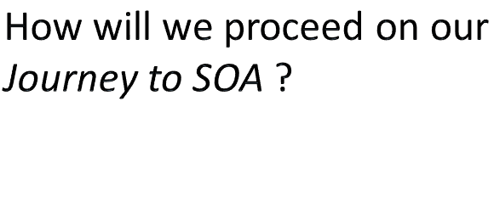
SOA and SET

Slide 24
Where we go next ?
SOA Overview
Today we’ve learned what SOA is – so now you’re wondering
  What kind of things will we be learning and doing in class to reinforce SOA ?
  What kind of Projects and Assignments will we be doing ?
We will start our SOA Journey by reviewing/learning about Web Services
  We will be learning about SOAP based web services
  We will be learning about RESTFUL web services
  We will be reviewing the grassroots concepts of SOA – CORBA and DCOM
In these Web Services, we will be
  Learning about how data is communicated to / from the service
    Using XML and JSON
  Learning about how security is ensured within the web service
And of course, we’ll try our hand at a Home-Grown SOA ☺

